Slide 1

CRISA Market Segmentation Analysis
Market Segmentation
From
Purchaser Demographics
To
Purchase Process and Brand Loyalty
Cost-effective
promotions
Fabrizio Fiorini
Fundamentals of Machine Learning
Kent State University

Slide 2
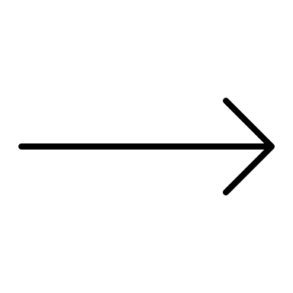

Brand Loyalty Metric
«Highest percentage of purchase by Brand»
K-Means Clustering Analysis
STEP 1
Purchase Behavior
STEP 2
Basis of Purchase
STEP 3
Purchase Behavior + Basis of Purchase

Slide 3
Purchase Behavior + Basis of Purchase
high socioeconoic environment
highest education level
lowest average volume per transaction
high average price
highest number of brand runs
highest numbers of brands
least brand loyal
Cluster 1
low socioeconoic environment
lowest education level
highest average volume per transaction
low average price
lowest number of brand runs
few numbers of brands
most brand loyal
Cluster 2
Cluster 3
Female majority
high education level
high numbers of brands

Slide 4
KNN Classification Model
Cluster 1 = SUCCESS
1
Data Partition: Tran set and Validation set
2
Predictors and Labels
3
Optimal K
4
Prediction
5
Confusion Matrix
6

